Slide 1
What should be name our shiny app?

Slide 2

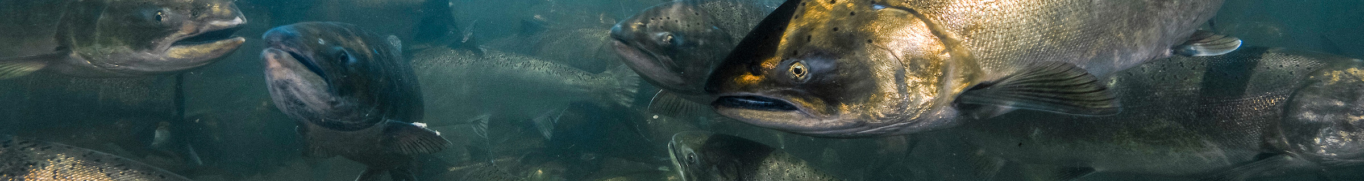
Home
What is Biosecurity
Summary statistics
Risk factors
Biosecurity evaluation
My biosecurity
Biosecurity key prevention to prevent the introduction, development and spread of transmissible animal diseases to, from and within an animal population.
Project description:
Funding agency:
Links to relevant websites:
Contact person:

Slide 3






What is Biosecurity
WELCOME!
The aim of our study was to obtain an overview of farm and health management, biosecurity measures, fish health monitoring and disease diagnostics of Norwegian Atlantic Salmon farms.
This app will allow you to visualize what biosecurity measures farmers apply on their facility and what factors are potentially associated with high mortality.
Home
What is Biosecurity
You will also be able to evaluate your farm biosecurity level with a biosecurity scoring system developed for Atlantic Salmon farms, on the basis of farm management and biosecurity practices
Summary statistics
Risk factors
Biosecurity evaluation
Collaborators:

Slide 4

What is Biosecurity
What is biosecurity:
Importance of biosecurity:
Home
What is Biosecurity
Summary statistics
Risk factors
Biosecurity evaluation
Biosecurity evaluation
External biosecurity
Internal biosecurity

Slide 5
Summary statistics
Home
What is Biosecurity
Summary statistics
Risk factors
Biosecurity evaluation

Slide 6
Risk factors
Home
What is Biosecurity
Summary statistics
Risk factors
Biosecurity evaluation

Slide 7
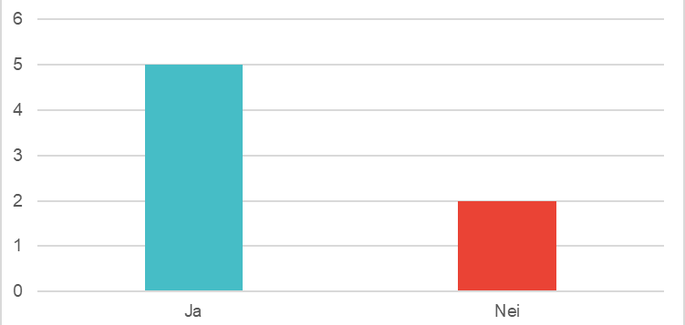
Biosecurity evaluation
In this section you can select a category from the survey and the questions that comprise it to get a summary of the responses
Select a category
Select a question
9.Utstyr & kjøretøy
9.4.Hvis utstyr blir benyttet ma
Home
What is Biosecurity
Summary statistics
Risk factors
Biosecurity evaluation

Slide 8
Biosecurity evaluation
This table shows the 30 variables found to have a statistically significant association with the occurrence of high mortality.
Home
What is Biosecurity
Summary statistics
Risk factors
Biosecurity evaluation

Slide 9
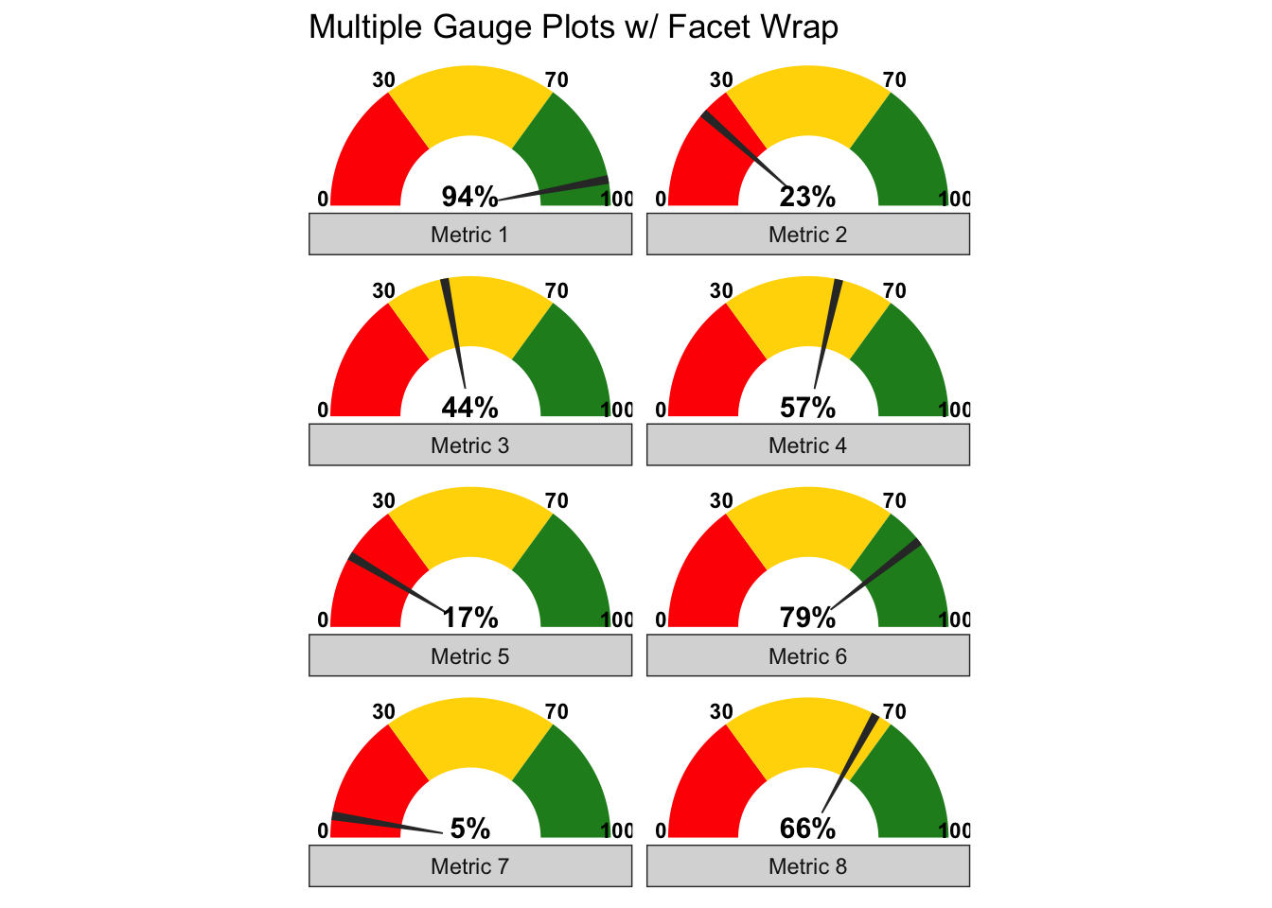
Biosecurity evaluation
Statistic for Norway
My scoring
This tab shows you the average biosecurity score based on all completed surveys
Overall biosecurity
External biosecurity
Internal biosecurity
Home
What is Biosecurity
Summary statistics
Risk factors
Biosecurity evaluation
External Biosecurity
1) Location of the farm | 75%
2) Introduction of eggs | 68%
3) Introduction of live fish | 55%
4) Feed and water supply | 72%
5) Biovectors | 88%
Number of surveys completed: 63

Slide 10
My biosecurity
Statistic for Norway
My scoring
Login
Email:
Password:
Home
What is Biosecurity
Summary statistics
margaridagl@hotmail.com
Risk factors
Biosecurity evaluation
***********

Slide 11
My biosecurity
Statistic for Norway
My scoring
External Biosecurity | My scoring | Average
1) Location of the farm | 80% | 75%
2) Introduction of eggs | 42% | 68%
3) Introduction of live fish | 66% | 55%
4) Feed and water supply | 89% | 72%
5) Biovectors | 95% | 88%
…
Home
What is Biosecurity
Summary statistics
Risk factors
Biosecurity evaluation
Recommendations
Introduction of eggs:

